Slide 1
Mapping the Department Application Capability Model to Technology Standards – how SAS and TA could help each other?
Claude Martel, Jean Lapierre, Marc-Andre Therrien, Keith Murphy, Nikolay Tsanov, Xenos Khan
February 7th 2020

Slide 2
Agenda (wide open-ended):
DevOps – mapping DevOps technologies to the appropriate standards (joint effort with Jeff Greco).
DevOps – mapping DevOps technologies to capabilities as per DACM (joint effort with Jeff Greco).
Does TA see anything in SAS’ work which they could reuse?

Slide 3
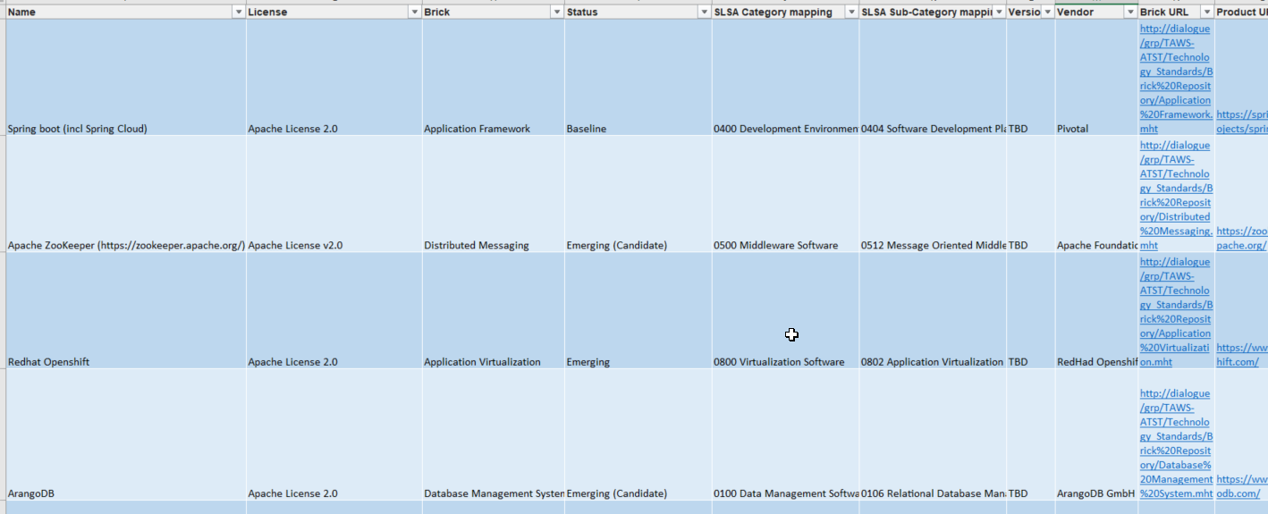
Mapping DevOps technologies to the appropriate standards
It’s a WIP in Excel format available at the link below.
Questions:
How to have this list verified and corrected by TA?
How to submit a proposal to TA to standardize the non-standardized technologies; how should the proposal take form, e.g. PowerPoint presentation, email, etc.?
http://dialogue/proj/ITCD-RMTI/SAS-SAS/Documents/Services/Projects/Continuous%20Delivery%20Pipeline%20and%20DevOps/References/DSBCurrentAndEmergingTechnologies_20191231.xlsx

Slide 4
DevOps – mapping DevOps technologies to capabilities as per DACM (joint effort with Jeff Greco).
SAS was beginning this work when it was announced that the Technology Standards were already mapped and this mapping will become available with QualiWare X.
Questions:
Will this mapping be “linkable” to objects using ArchiMate notation (i.e. symbols on diagrams)?
How “granular” is the mapping done by TA, e.g. is it standard-to-capabilities, technology-to-capabilities or something else?

Slide 5
Does TA see something in SAS work which they could reuse?
Questions: To be determined during the meeting.

